Slide 1
Plastic Packaging
Plastic Polymerisation
Notes:
Introduction
Welcome
Background to FPC
Important contribution to the food industry

Slide 2
Contact
Tony Duffy
tony-duffy@outlook.com
++44(0)7526497265

Slide 3
Plastic & Polymers
Plastic: Easily shaped or moulded
Polymer: Poly (many) mer (parts)
Monomer: Mono (one) mer (part)
Natural include cellulose, rubber, starch
Synthetic include most common plastics
Derived from crude oil/gas
Bio-based

Slide 4
Plastic Production
4% of fossil fuel production goes into plastic
380 million tonnes produced per year
50% of plastic produced is used in packaging

Slide 5
Plastic History
1200 BCE, Aztec used natural rubber
1820’s vulcanised rubber, cellulose
1869 Celluloid Billiard balls
1907 Bakelite – synthetic plastic
1937 Commercial Polystyrene production
1938 Commercial Nylon production
1945 Polyethylene squeezy bottle

Slide 6

The Future is Plastic (1967)

Slide 7
Production of monomers
Crude oil refined by fractionation
Based on boiling points of materials
Cracking is used to fracture large molecules into smaller molecules which can be used to produce required components.

Slide 8
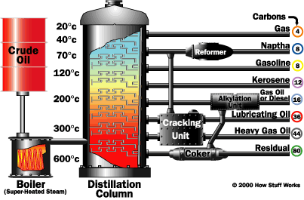

Slide 9
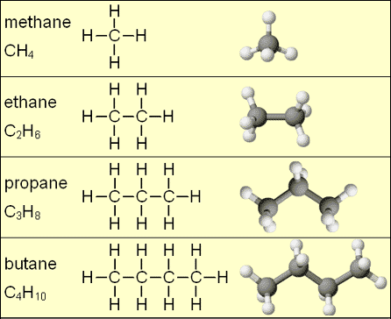
Simple hydrocarbons
Methane CH₄
Ethane C₂H₆
Propane C₃H₈
Butane C₄H₁₀
Pentane C₅H₁₂

Slide 10
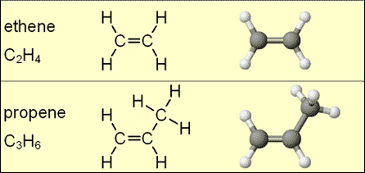
Alkenes (containing double carbon bonds)
Ethylene C₂H₄
Propylene C₂H₂CH₃

Slide 11
Monomers & Polymers

Slide 12
Polymerisation Processes
Free radical addition polymerisation
Coordination addition polymerisation
Condensation polymerisation

Slide 13
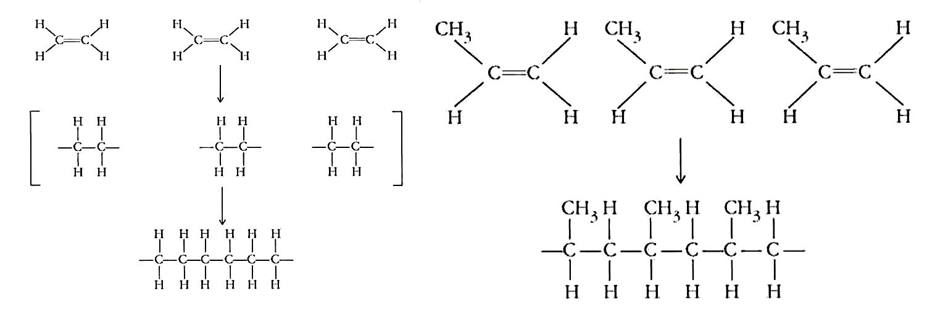
Addition Polymerisation

Slide 14
Free radical initiation
Free radical: molecule fragment with unpaired electron
E.g. Peroxides R-O-O-R
Split into two free radicals R-O* *O-R
Free radicals are reactive and will easily pair with other molecules

Slide 15
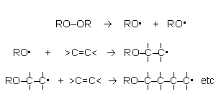
Initiation and Propagation

Slide 16
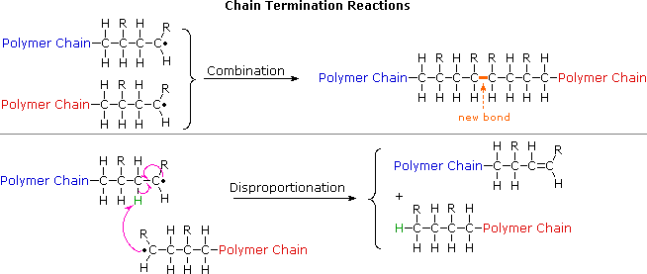
Process termination

Slide 17
Coordination Initiation Ziegler Natta or metallocene
Catalysts (and co catalysts)provide reactive sites
Titanium based
Reactions take place on the surface of the catalyst

Slide 18
Propagation
Additional monomers attach themselves between the reaction site and the attached molecules.
Process continues for a large number of molecules forming long chains.
Can control arrangement of monomers

Slide 19
Termination
Polymer chin becomes detached from catalyst and is no longer reactive.

Slide 20
Polymerisation Processes
Free radical addition polymerisation
Coordination addition polymerisation
Condensation polymerisation

Slide 21
Condensation Polymerisation
Reacts two monomers
Monomers have functional groups
acids, alcohol, amine
Have 2 or more reactive sites
Monomers join and release a small molecule often water

Slide 22

Nylon

Slide 23

PET

Slide 24
Cross Linking
Some monomers have three or more reactive sites.
Polymer chains can bond to reactive sites joining chains together.
Polymer chains can form a network of inter-linked chains.
Usually thermoset plasticsCrosslinking polymers with organic peroxides (youtube.com)

Slide 25
Plastic types

Slide 26
Plastic types Thermoplastics
Long molecules
Often carbon backbone
Independent polymer chains
Softens on heating
All common packaging plastics
PE, PS, PP, PVC

Slide 27
Plastic Types Thermoset
Polymer chains are cross linked (bonded)
Once polymerised shape is permanent
Will not soften with heat
Includes
Epoxies, uera formaldhyde,

Slide 28
Plastic Types Thermoplastic Elastomers (TPE)
Rubbery Thermoplastics materials
Blends or copolymers
Advantages of thermoplastics
Feel of thermoset elastomers.
Styrene co-polymers
Thermoplastic copolyester

Slide 29
Break

Slide 30
Modification of Polymers
Monomer
Molecular weight / distribution
Co Polymerisation
Tacticity
Chain Branching
Polarity
Crystallinity
Orientation

Slide 31
Polymer properties
Monomer
Polyethylene C₂H₄
Polyvinyl chloride C₂H₃Cl
Polyvinylidene chloride C₂H₂Cl₂
Polypropylene C₂H₃CH₃
Polystyrene C₂H₃C₆H₅
Size of replacement group: Glass transition, stiffness crystallinity,

Slide 32
Molecular weight
Molecular weight is size of polymer molecule.
How many monomers have been added to the polymer chain?
Impacts on stiffness, melting point, viscosity (MFI)

Slide 33
Molecular Weight Distribution
Measurement of distribution of molecular size
Narrow distribution
Well defined properties e.g. melting temperature
Wide distribution
Range of properties e.g. melting temperature

Slide 34
Co-polymerisation
Co-polymer constructed from 2 or monometers
Arrangements can vary
Block
Random
Alternating
Graft
AAABBBBBAAABB
AABAABBBABB
ABABABABABABA
AAAAAAAAAAA
B
B
B

Slide 35
Tacticity
3D arrangement of molecules e.g. PP
Atactic
Random dispersion of methyl group
Isotactic
All methyl groups on same side
Syndiotactic
Methyl groups arranged on alternative sides

Slide 36
Chain Branching
Polymer chains are not always straight chains.
Some side branches may be produced.
Amount of branching affects density

Slide 37
Structure of Polyethylene

Slide 38
Polarity
Non polar PE PP
Low surface energy, repel water, inks adhesives
Use corona treatment (or other ) to charge surface to attract ink
Polar materials have regions of +ive charge and –ive charge
-ive and +ive areas attract

Slide 39
Crystallinity
Crystallinity is areas of structured tightly packed polymer chains
Effects stiffness, permeability, opacity,

Slide 40
Crystallinity
Amorphous Polymers
random chains
Semi-Crystalline Polymers
Ordered regions within amorphous mix
Effects
Clarity, Stiffness, Permeability, Melting temperature

Slide 41
Crystallinity

Slide 42
Amorphous vs Crystalline plastic properties:

Slide 43
Polymer Morphology
The Random Coil
Polymer foetal position
Polymer Chain Branching
e.g. HDPE, LDPE, LLDPE

Slide 44
Orientation
Alignment of molecules
Cold processes & Hot processes
Axial and biaxial
Properties
Increased tensile strength, barrier properties,melting temperature

Slide 45
Thermal Properties
Melting temperature (Tm)
Crystallization (Tc)
Glass transition (Tg)

Slide 46
Heat Shrink Film
Heat polymer to allow some chain movement
Orientate by stretching
Rapid Cooling to “freeze” in structure
Re-heating to enable relaxation to random coil

Slide 47
Stretch Film
Elastic properties of film

Slide 48
Mixing Polymers
Co-Polymers
Blending / Compounding
Co-extrusion / Co-moulding
Laminating
Coating

Slide 49
Plastic Performance Properties
Tensile strength
Tear strength
Impact strength
Heat seal-ability
C of F
Creep
Permeability
Transparency
Chemical resistance
Temperature range
Glass transition
Melt temperature

